Slide 1
BLACK PEPPER CUTTING MACHINE
GROUP 4

Slide 2
GROUP MEMBERS
AMEEN K.S
ARUN SAJI
JOEL JACOB THOMAS KALATHIL
SARATH K.S
Project Guide:
JINESH K.J

Slide 3
ABSTRACT
The project deals with the design and the fabrication of black pepper cutting machine.
The machine is portable and will shred the whole plant . It will shred the whole plant including the leaves but it will not affect the growth of the plant.
The machine is kept in a platform. And the movement of the machine is done by rack and pinion technology.
A zig zag blade is used for cutting. The shredded leaves and black pepper is collected using a net.
The machine move vertically using rails and using rack and pinion technology.
It will shred the whole plant and the whole shredding will not affect the growth of the plant as the root the plant is not damaged .

Slide 4
INTRODUCTION
Black pepper is a good source of income for the farmers. But they are facing trouble in plucking the black pepper.
The plucking of black pepper is usually done manually with more number of labours. This consumes a lot of time and also an extensive labour charge is there.
Manual climbing is a hazardous task and many people have lost their lives because of doing it in improper way, with no safety gear and knowledge.
With labor being scarce in contemporary agriculture it has become very difficult during harvest time.
Hence automation is the best solution to eliminate human intervention and save time and money.

Slide 5
This project presents the design and fabrication of a Black pepper Cutting Machine.
This can be set up and run by two people and is farmer friendly.
There have been many attempts and designs for this type of robot, but most of them mimic the climbing robot for this.
Our project does not mimic climbing robot, Instead it uses a vertical rail placed parallel to the pepper plant and the machine will shred the whole plant . It will shred the whole plant including the leaves but it will not affect the growth of the plant.
The machine is kept in a platform. And the movement of the machine is done by rack and pinion technology.

Slide 6
OBJECTIVES
Platform Mechanism : A platform has to be designed and fabricated for holding the machine . The platform should be light and easy to carry and should withstand the weight and pressure of the machine.
Cutting Mechanism: A zig zag blade is chosen for the cutting of the black pepper. Zig zag blade will be more suite for this system than the rotary blade as the shredded pepper will not be splashed away.
Robot : A robot is used for this process. The robot will move up and down using vertical rails and it is controlled by a microcontroller.

Slide 7
LITERATURE SURVEY
Arecanut Tree -Climbing and Pesticide Spraying Robot using Servo Controlled Nozzle
(Atreya G Bhat)
This paper aims at the design of a rugged and light-weight Semi-Autonomous Robot which can ascend the areca tree
Spray the pesticides through a Laser guided servo-controlled nozzle.
The spring based gripping can adjust automatically according to the varying trunk diameter and provides the required traction for climbing the tree.

Slide 8
Voice Assistance Goods LIfter using Rack and Pinion
(Arun Karthik S , Jasmine Batra , Sachin K , Shiv Sanjay Makadia)
In this research focuses on the robot controlled by the voice which does the lifting of the goods using the Rack and pinion mechanism.
The robot helps the rack and pinion mechanism to move to its desired place which is attached to it so that it can be used to lift heavy loads.
The system will take the voice inputs through the Bluetooth module and will pass on to the Arduino to do the process

Slide 9
Design and Simulation of Special Hexapod Robot with Vertical Climbing Ability
(Zihan Zhou , Xiaoqin Zhu)
Introduction of the mechanical structure of the hexapod robot and the design of the 6 legs.
The experimental results show that the robot has the possibility to climb vertical walls, which has important theoretical and practical significance.
Hexapod robot can be equipped with some special detectors to achieve some difficult tasks.

Slide 10
METHODOLOGY
A horizontal zig zag blade is used for cutting.
A rail is used for the movement of the machine.
A stepper motor is used for the precise control of the machine.
A lithium ion battery is used for the running of motor.
The machine will move using the rails and the blade will cut the whole pepper.
A net or any carrying bag will be placed under it to collect the pepper.
A microcontroller is used for controlling the machine.

Slide 11
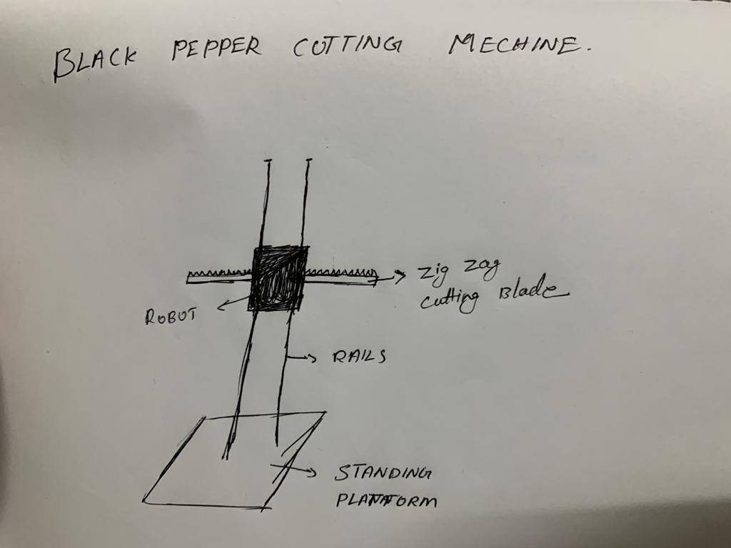
DESIGN

Slide 12
BUDGET
Aluminium rails 1200
Stepper motor 1800
Stepper motor controller 500
Cutting blade 1000
Microcontroller 1500

Slide 13
CONCLUSION
We found the papers and objectives for the project
Implement a design for basic structure
Researched about the availability and prices of the required components
The funds and estimate for the project has been finalised

Slide 14
REFERENCES
Arecanut Tree -Climbing and Pesticide Spraying Robot using Servo Controlled Nozzle
(Atreya G Bhat)
Voice Assistance Goods LIfter using Rack and Pinion
(Arun Karthik S , Jasmine Batra , Sachin K , Shiv Sanjay Makadia)
Design and Simulation of Special Hexapod Robot with Vertical Climbing Ability
(Zihan Zhou , Xiaoqin Zhu)
Design and implementation o f automatic apple crating
robot technology
(Kun Zhang, Hua Zhang)

Slide 15
THANK YOU

